Slide 1

Introduction to Programming using Scratch
CS.001
Notes:
Good morning everyone! So as you already heard (from the introduction) my name is Anthony Consoli, I graduated WHS in 2012 so I’m not THAT much older than some of you guys. I am studying computer science in college and basically today I want to show you guys a thing or two about computer programming and “coding”. So let’s get right too it as we only have so little time.

Slide 2
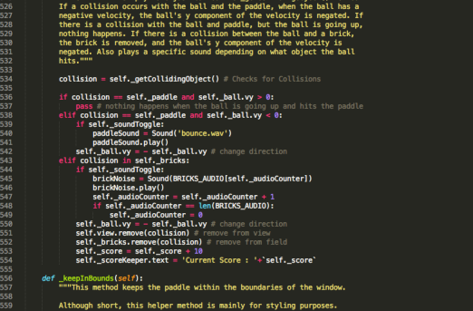
What is Code?
And how is it prevalent to today’s world?
Notes:
I’m guessing most of you have heard the words, “programming”, “code” but don’t understand what it means. I first saw this stuff in movies, with crazy bad guys typing really fast on a keyboard and writing sentences that look like abosulte gobbly-gook to me. The reality can’t be further from this; programming/coding, which are really the same thing is very easy to do. The hard part comes when you have to come up with WHAT to program.
What I’m going to show you today is a basic introduction in HOW to program with the hopes that some of you will continue to learn on your own. By learning how to code you will have a tool to create anything that you want.

Slide 3
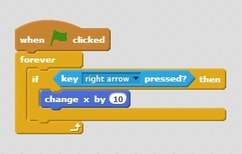
Code
010101001001011100101001010101010101010100111010101100111000110100111001010101100110110000011010010010101000100110011001001001100
Binary
mov abx3e321, e32
mov 324aev,231fba1
eax f2va33,ffa3a34
edx 249gjfa,23f2fa
Assembly
Scratch
Notes:
Scratch is a simple and easy way to tell our computer what we want it to do.

Slide 4




Starting / Using Scratch
To Start Scratch
Click the Google Chrome Icon On your desktop
go to Scratch.mit.edu
To begin log into scratch
Click “Sign in” in the top right corner
Username: School ID
Password: (capital P) Password1
Now let’s write our first program!

Slide 5
Super Swimmer
Introduction to Scratch and Computer principles through creating a game

Slide 6
Super Swimmer
Super Swimmer Is a game originally created by Peter mountanos Using Scratch
The objective of the game is to collect as many fish as you can while avoiding the sharks
Today you will learn about some of the basics of programming through making a super swimmer game of your own!
Try out Peter’s version of super swimmer here!
http://scratch.mit.edu/projects/3310840/

Slide 7
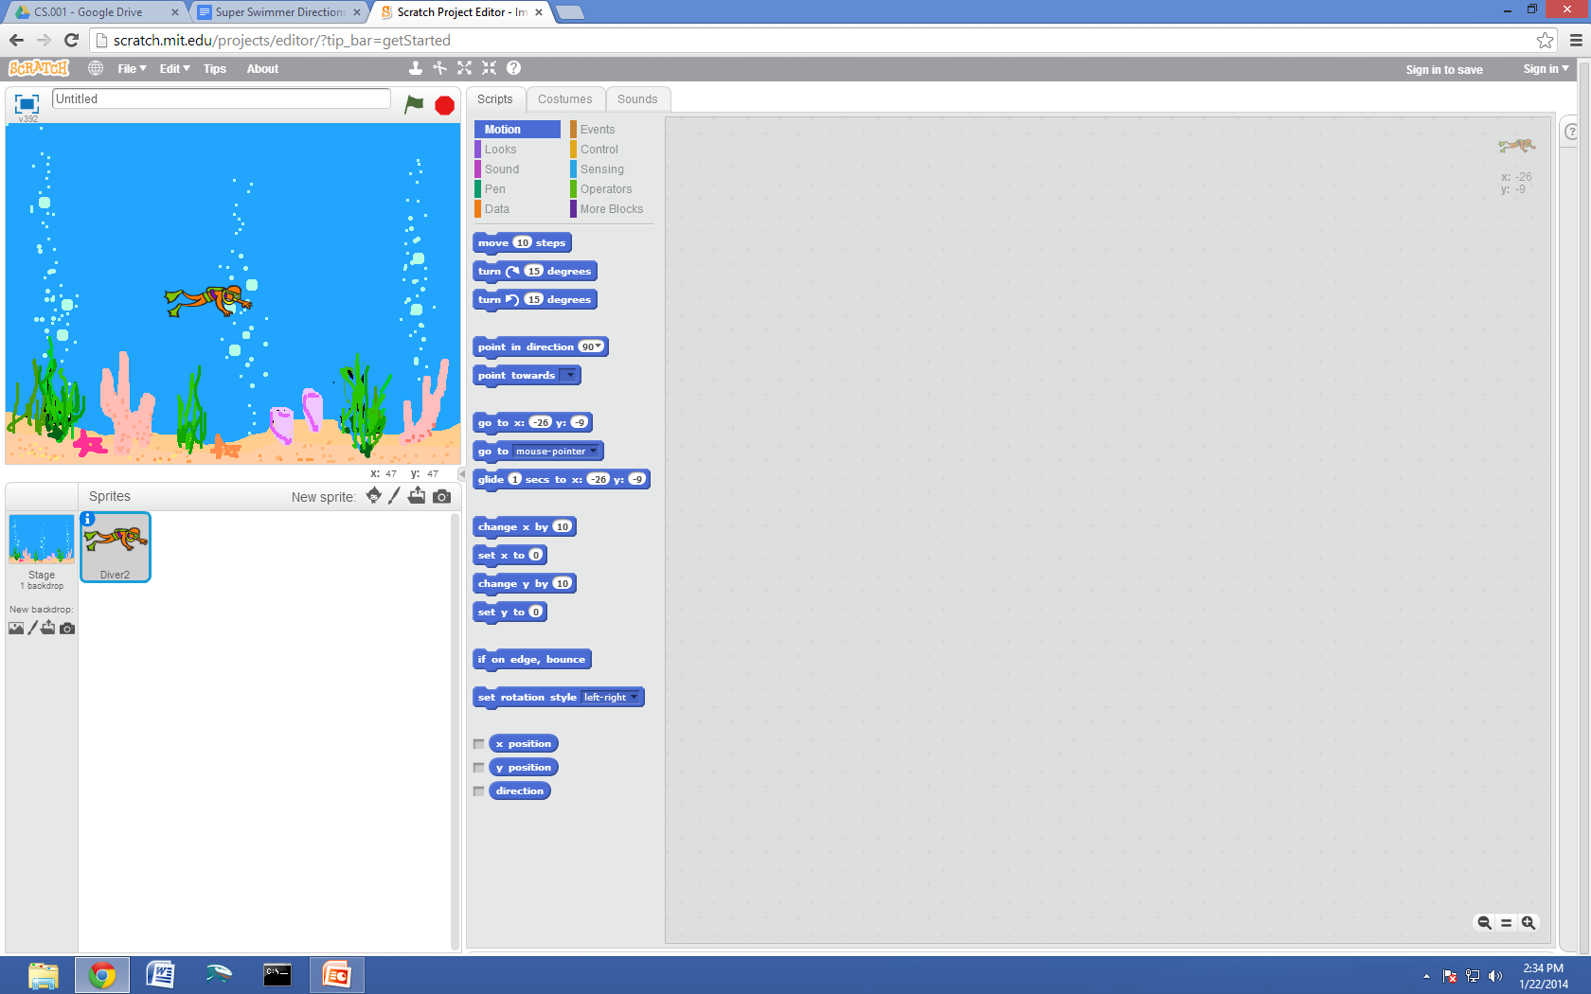
Setting up super Swimmer

Slide 8
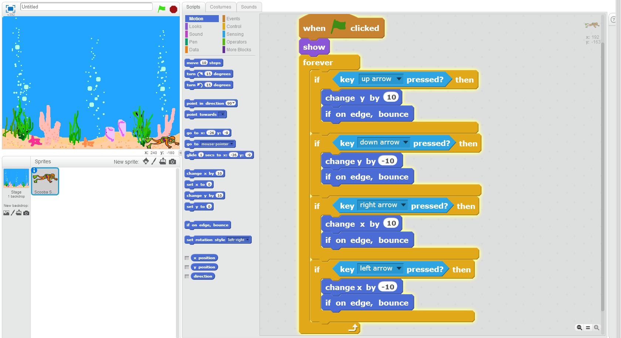
Moving Our Diver

Slide 9
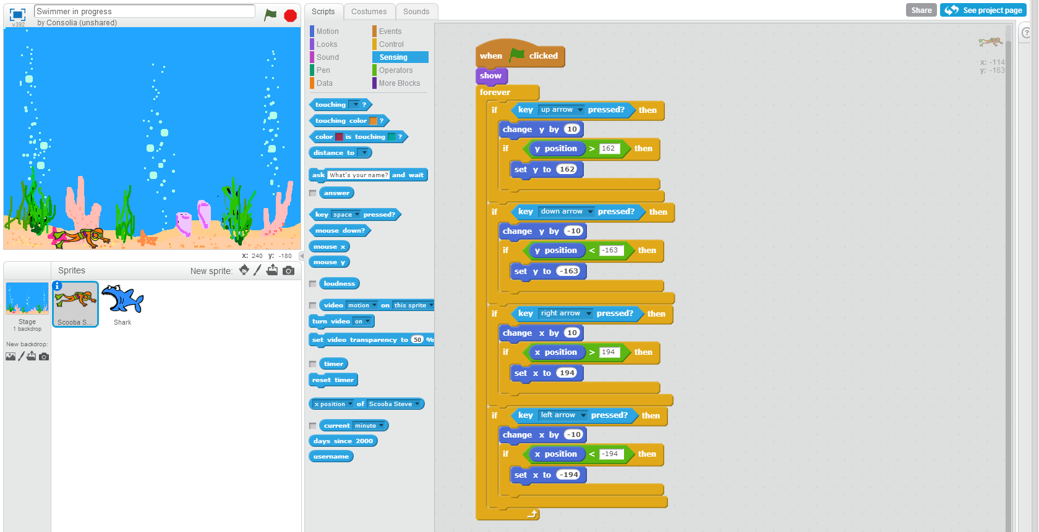
Moving Our Diver Revised

Slide 10
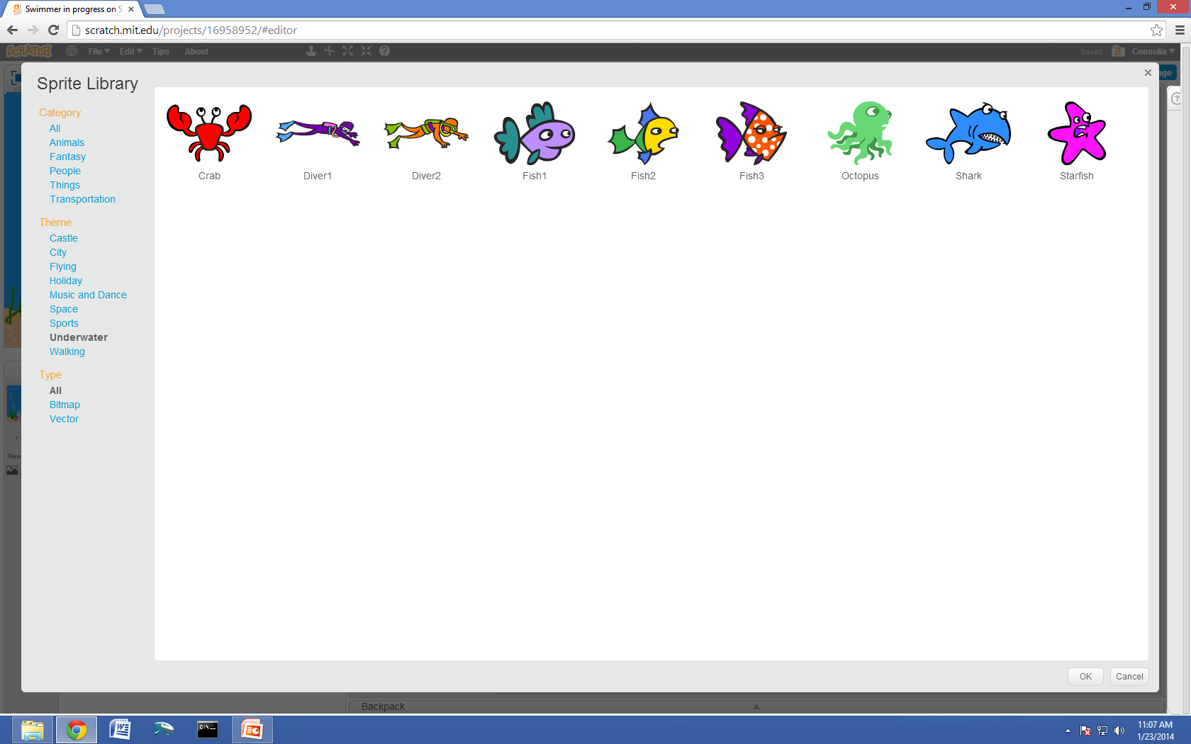
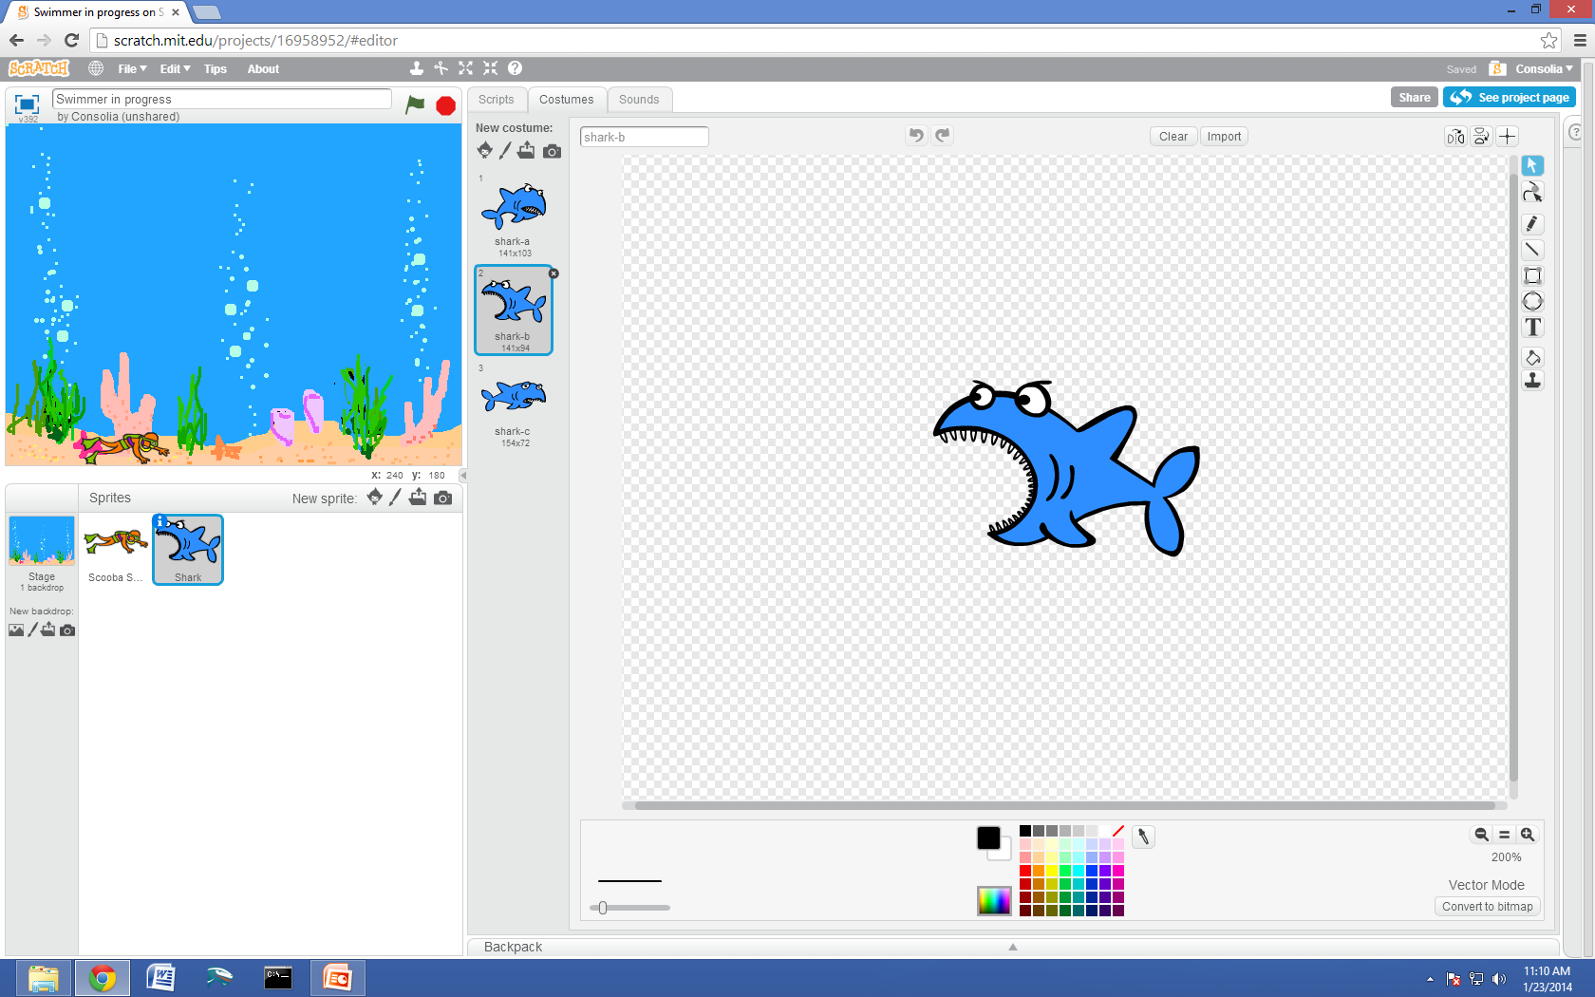
Adding The Shark

Slide 11
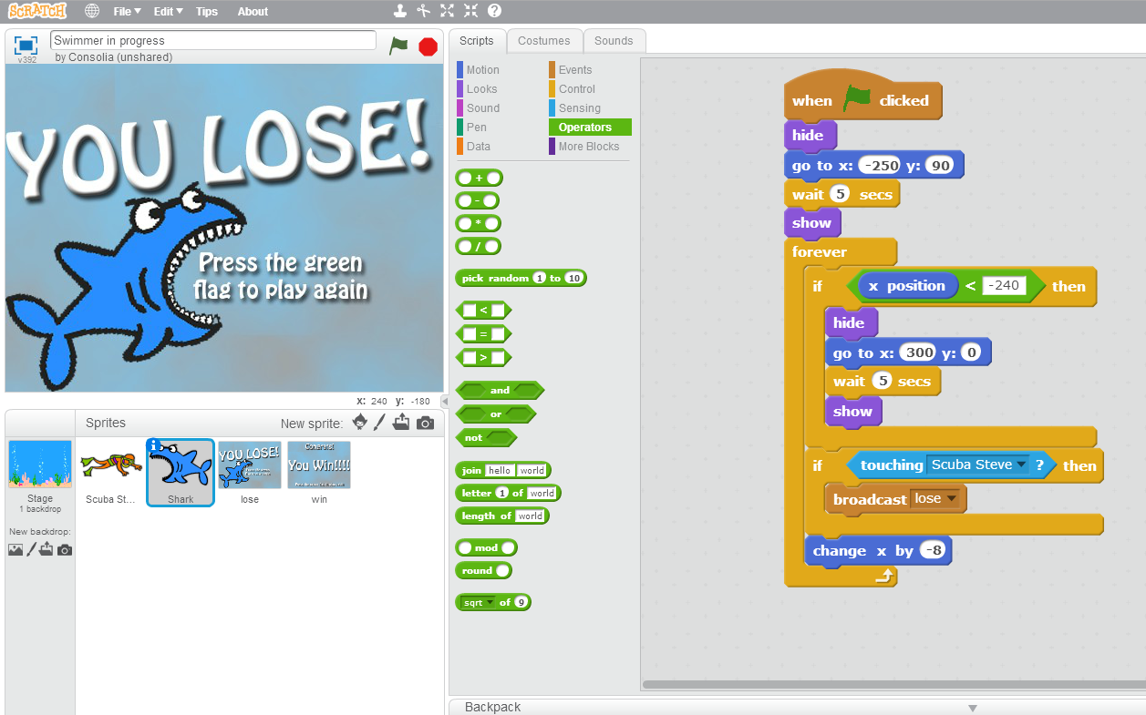
Getting the Shark to move

Slide 12
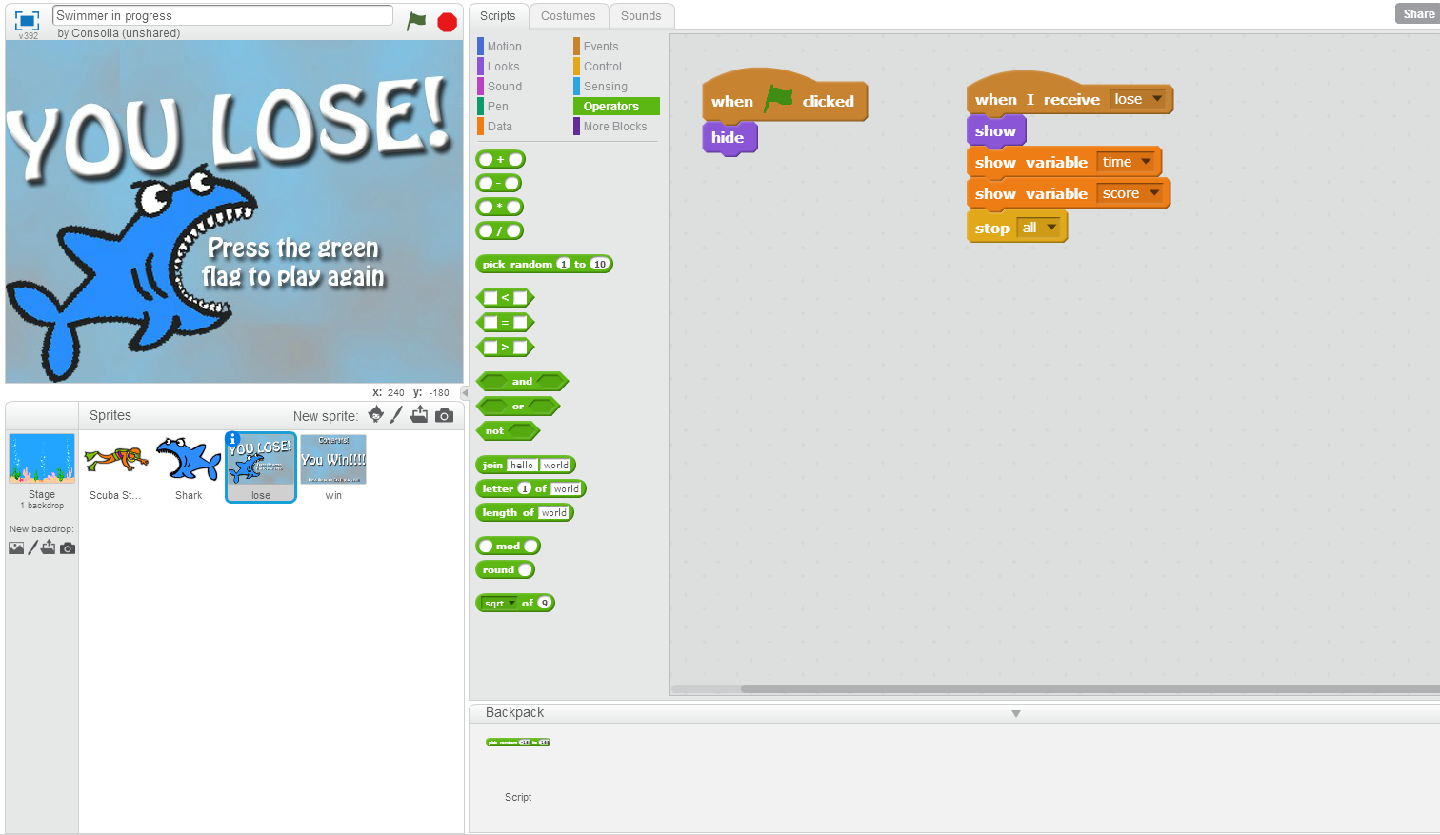
Adding lose sprite

Slide 13
Test your game
Avoid the shark one time
Get Eaten by the shark the second time
**Testing is an extremely important part of programming**

Slide 14
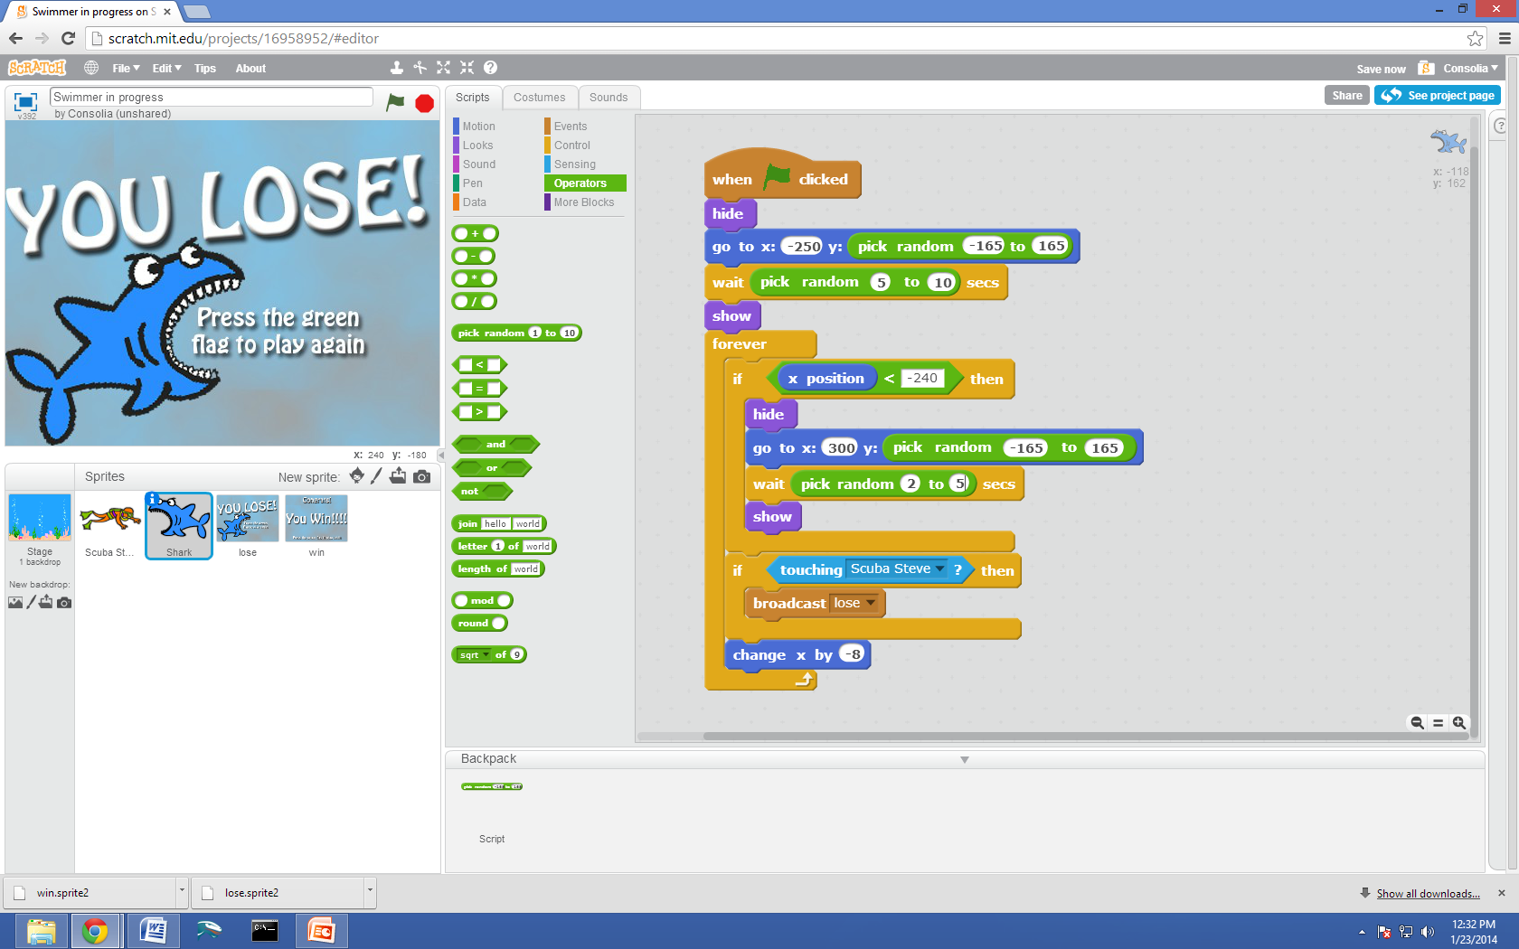
Making the shark random

Slide 15
Adding our first fish
After you have copied and pasted the code from the shark, test the game.
Try to catch the fish and the raise your hand if you notice the problem

Slide 16
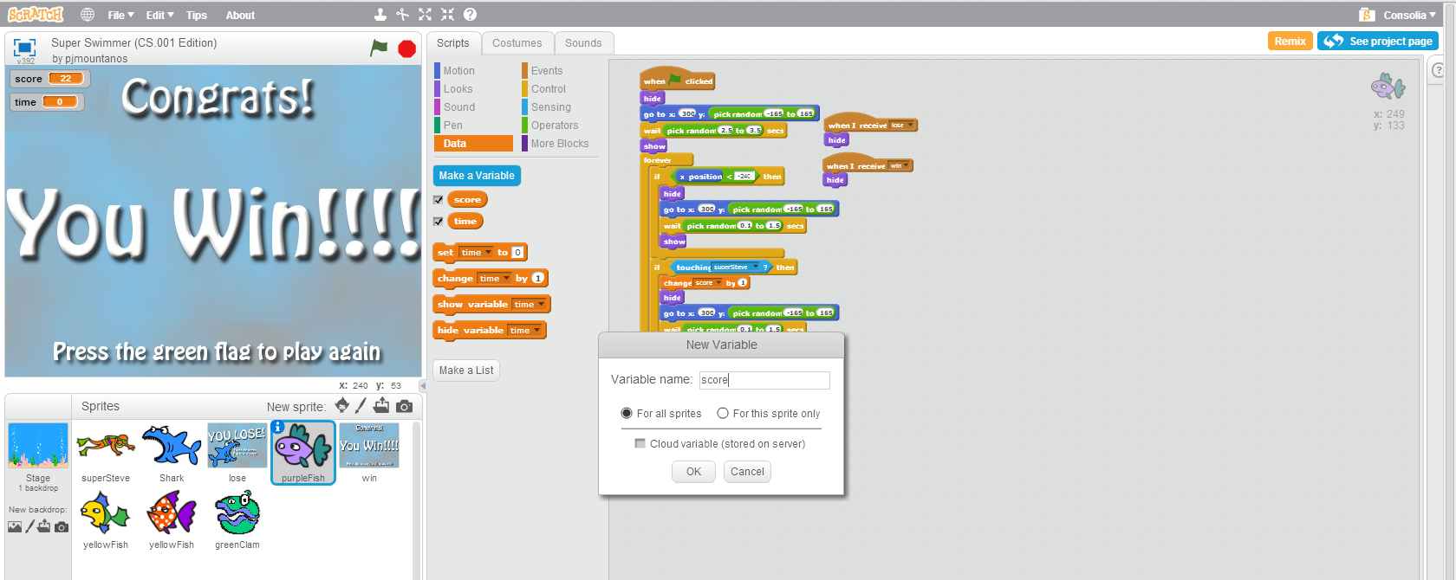
Making our first variable

Slide 17
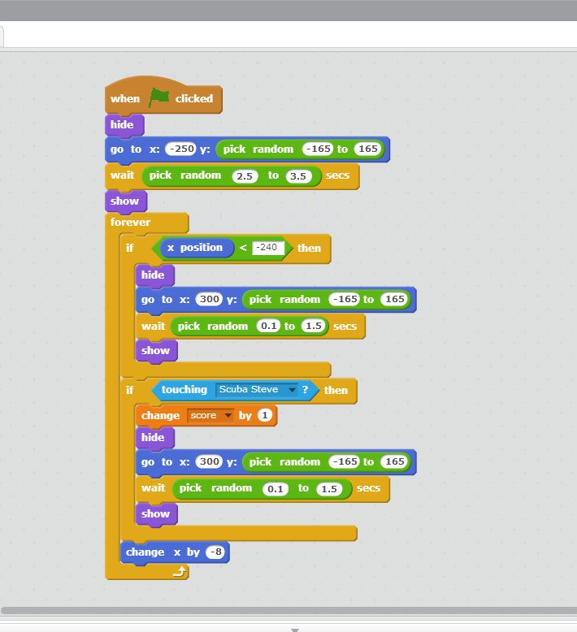
Fixing our problem

Slide 18
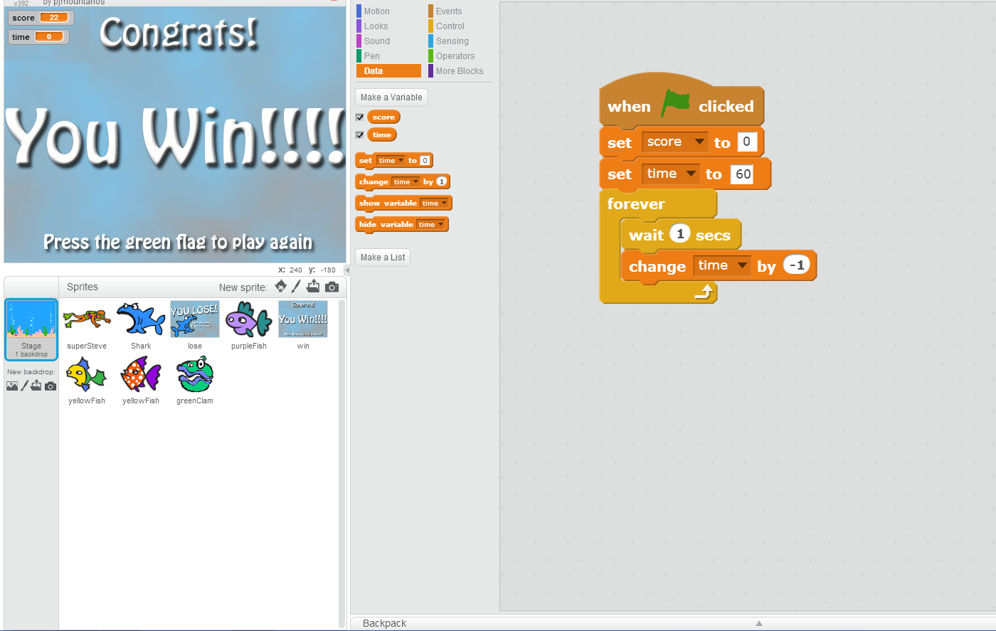
Making a time variable & Initializing variables

Slide 19
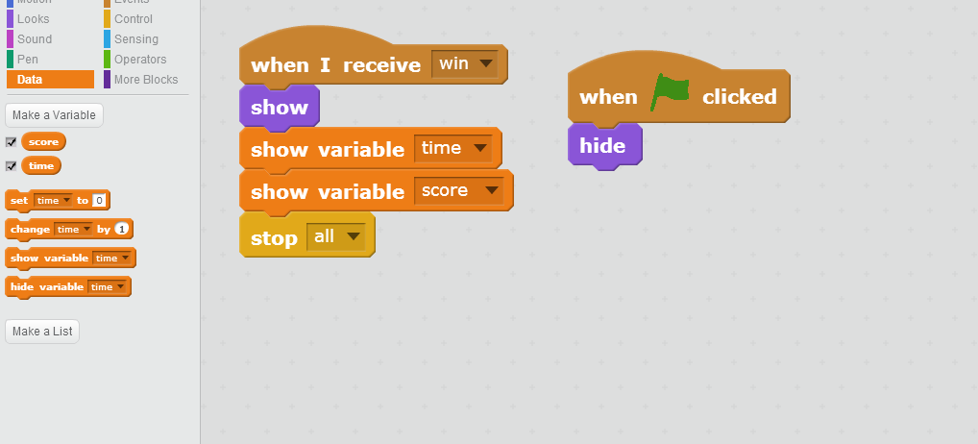
Adding win sprite
First we must upload the win sprite just like we did with the lose sprite and center it on the screen
After that we should edit the script for the win sprite to look like this.

Slide 20
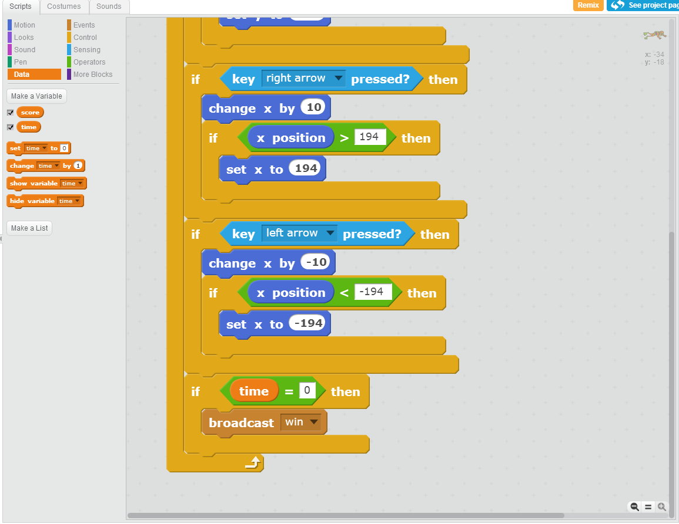
Altering Scuba Steve/Sally’s script to account for time

Slide 21
Now we all should have the basic functionality of the game
Test the game
After you have tested your game it is time to add more fish to make the game more interesting

Slide 22
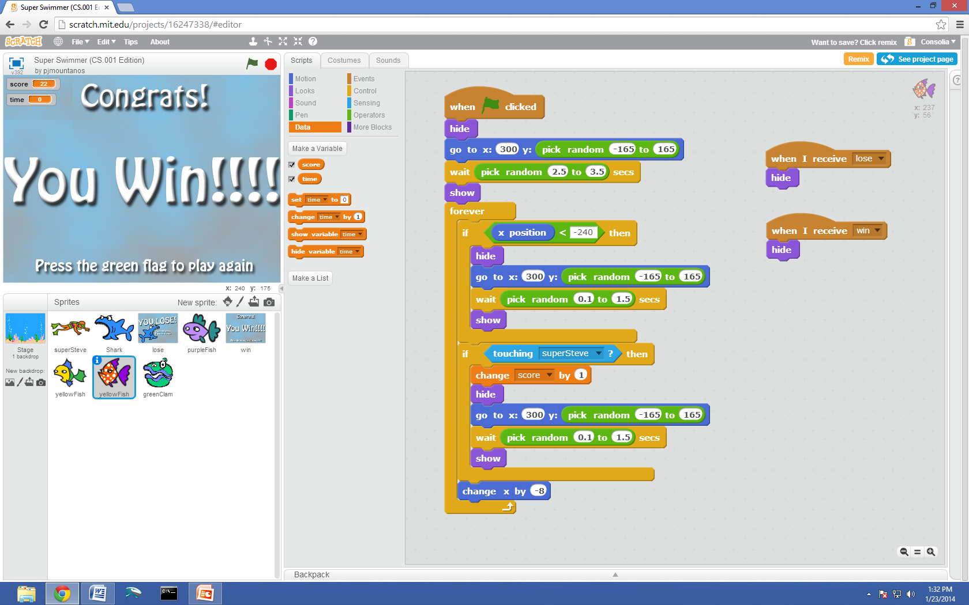
Adding more fish
We will be adding the red fish and the green fish just like the purple fish and then duplicating the code from the purple fish into the others.

Slide 23
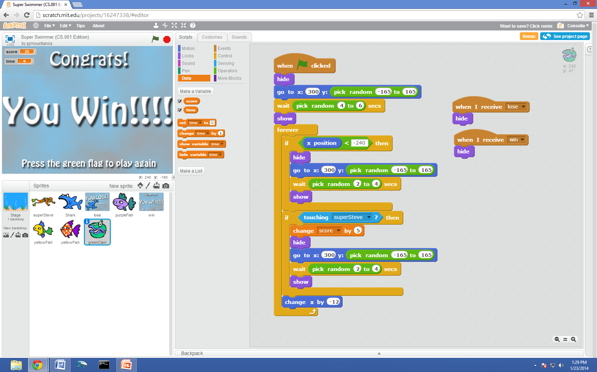
Making the clam a rare catch
After uploading the green clam sprite you will change the clam’s script to make it harder to catch.
This also means the clam should be worth more points

Slide 24
Finishing your game
By adding this code to the scripts of all of the character spites it will ensure that all of the fish are hidden when you win or lose.

Slide 25
Challenge
Check out the full version of super swimmer to see all of the other cool things you can add to your game.
Try to add power-ups and other features to your game using what you have learned while creating it.
If you have ideas of your own feel free to try to put them into your game to make it even better.
THE possibilities ARE ENDLESS

